Slide 1

Design Patterns
LESSON 1: intro
CREATIONAL PATTERNS
resources

Slide 2
Timeline
Course Presentation
(throughout the whole semester)
Choose a pattern to present
Lab Presentation
(let’s decide together)
Option1: integrate 5 design patterns in your thesis
Option2: create a new application from scratch and integrate 5 design patterns
Final Colloquium
(final weeks)
Conversation about design patterns
Tips: prepare 2 design patterns examples from an open-source project, library, framework
Schedule your presentation
Prepare a live presentation
My recommendation for the presentation structure: what problem is solved, concepts (summary of basic ideas), design (UML diagrams, explain actors), pitfalls, maybe a comparison between your pattern and the one previously presented, if it makes sense

Slide 3
What are those? Motivation, benefits
Design patterns are common solutions to common problems in software design.
Each pattern is like a blueprint that you can customize to solve a particular design problem in your code.
Patterns are a toolkit of solutions to common problems in software design. They define a common language that helps your team communicate more efficiently.
Are patterns as good as advertised?
Is it always possible to use them?
Concrete, well-tested solutions
A clearer picture of how you are implementing the design
A common language and jargon for programmers.
Notes:
The essential thing when approaching design patterns is to utilize them in a way that improves our codebase. The above means that we sometimes can bend them to fit our needs.
They are commonly associated with object-oriented programming. That doesn’t change the fact that we can take its fundamentals and apply them to something else.
There’s a popular quote: if you have a hammer, everything looks like a nail, it can be a trap.
React DOM - composite
valueOf flyweight, I suppose useMemo
Observable Angular
Iterator
Decorator
Dupa cum va puteti imagina, fiind solutii propuse demult, discutate intens, multe limbaje de programare au adaptat implementarea lor cu aceste patterns
Fortare chiar daca nu se potriveste in contextul priectului
Exista si alte patterns, noi le vom discuta doar pe cele clasice
Matrite pentru probleme recurente, nu functioneaza ca si librariile, ca iei si folosesti codul, trebuie sa se potriveasca cu realitatea proiectului
Cand invatati un pattern, voi sau ii invatati pe altii: intentie, motivatie, structura, exemplu

Slide 4
Classification
Creational patterns provide various object creation mechanisms, which increase flexibility and reuse of existing code.
Singleton, Factory Method, Abstract Factory, Builder, Prototype
Structural patterns explain how to assemble objects and classes into larger structures while keeping these structures flexible and efficient.
Adapter, Bridge, Composite, Decorator, Façade, Flyweight, Proxy
Behavioral patterns handle how objects interact: communication, dependencies, isolation.
Chain of responsibility, Command, Iterator, Mediator, Memento, Observer, State, Strategy, Template Method, Visitor
Creational Patterns
Structural Patterns
Behavioral Patterns
Notes:
Creational = mecanisme de creare a obiectele pentru a oferi flexibilitate si reutilizare a codului
Structural = asamblarea obiectelor si a claselor, integrarea lor structuri mai largi, lasand totusi flexibilitate. Aici o sa fie mai grele exemplele, pentru ca nu o sa lucram pe structuri largi
Behavioral = se refera mai mult la algoritmi si asignarea responsabilitatilor intre obiecte

Slide 5
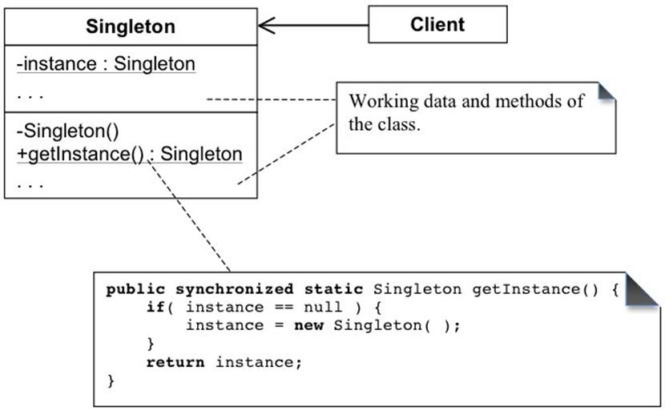
Singleton
Problem: control access to a shared resource
Solution: do not allow creation through “new” keyword by having a private constructor + static method to return a cached instance (object)
Notes:
The most common and easy to implement pattern.
Used too much, might slow down your app, becomes a problem if you’re not careful to make it thread safe.
Three important characteristics: only one instance, lazy-loading, thread-safe.
Lazy loading vs eager loading = load when you actually need something (if null, instantiate) vs init resources as soon as code is executed (e.g loading at the beginning of website, setup)

Slide 6
Singleton in a few words + examples from open-source projects
Think of it as having the same advantages and disadvantages as global variables
A lot of developers consider Singleton as an anti pattern
Recognize it by identifying a static method to get a resource
Usages: logging class, manage database connection (or a pool of connections), global state
JavaScript: ES6 modules
https://codesandbox.io/s/es6-singletons-gwrv3
Firebase: https://firebase.google.com/docs/reference/android/com/google/firebase/auth/FirebaseAuth
Java: https://docs.oracle.com/javase/8/docs/api/java/lang/System.html#getSecurityManager--
Redux: the state tree from redux
https://redux.js.org/understanding/thinking-in-redux/three-principles

Slide 7
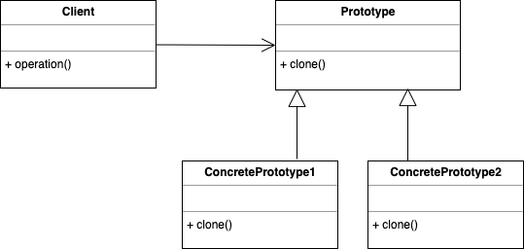
Prototype *a prototype is an object that supports cloning
Problem: you need objects with the same structure (same fields, methods, event private ones)
Solution: have a common interface for all objects that supports cloning, each object being responsible to return a copy through a “clone” method
Notes:
It helps improve object creation costs.
You will probably refactor it than implementing at the start of the project. How it’s done, you usually start having performance issues, because it’s costly to create huge objects.
No subclasses, it’s an interface.
You don’t use “new”, you use clone method
Even if it is a copy, each object is a new instance, so it’s not like in the singleton situation.
One important concept here: shallow copy vs deep copy.
The difference stays in memory location. I make a shallow copy B of object A, B will point to location of A (not for primitive types, obviously).
If I change something in A, B will be changed as well.
If I make a deep copy, I copy everything from A in B, is like a fresh copy.
There are ways of creating deep copies, it’s more costly, it’s complicated, recursive.

Slide 8
Prototype in a few words + examples from open-source projects
All objects that support cloning need to follow the same interface
Clone an object when, at runtime, you need a “true” copy of an object. (the actual copy of the object, with its current values)
Recognize it “clone” or “copy” method
Use it when it is costly to create new objects from scratch
JavaScript: prototype inheritance
https://repl.it/@khaled_hossain_code/prototype
Java: https://docs.oracle.com/javase/8/docs/api/java/lang/Cloneable.html
C#:
https://docs.microsoft.com/en-us/dotnet/api/system.icloneable?view=net-5.0
Python: copy module
https://docs.python.org/2/library/copy.html

Slide 9
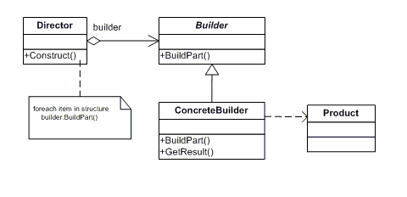
Builder
Problem: huge constructors, with optional parameters
Solution: built each step one at a time (optional: create a Director class that has a Builder, so you can control the order)

Slide 10
Builder in a few words + examples from open-source projects
Has setter for each field, where “this” is returned and a method for retrieving the created object
Usually, you will realize you use it more than you create it by hand
Step by step creation of a complex object.
Use it when you create an object in multiple steps or in a specific order.
You can recognize it upon this format:
someBuilder.setValue(x).setAnotherValue(y)…
Java: StringBuilder, StringBuffer, Locale.Builder
Spring: UriBuilder
You can find more by yourself, I’m sure! ☺

Slide 11
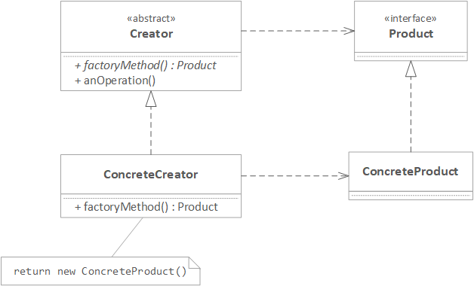
Factory Method
Problem: many if conditions when creating objects
Solution: usually pass type to a factory method and that method will return the corresponding object using new keyword, as usual

Slide 12
Factory method in a few words + examples from open-source projects
Common interface for products, implemented by concrete classes. The client does not know with what kind of product it works.
Usually, you have a parameter used to decide which concrete class is going to be instantiated.
If you want to choose the type of a product (object) at runtime, factory is the only one suited for that.
Any function. It is NOT a class, NOT a constructor, it returns an object.
Java: java.util.Calendar, ElementBuilderFactory, ResourceBundle, NumberFormat, BeanFactory Spring, ThreadFactory, Signature,
Android: Android.Graphic.Drawables
JavaScript: Factory for creating UI components https://github.com/FrontendMatter/dom-factory
React.DOM for creating elements (when you don’t use JSX)

Slide 13
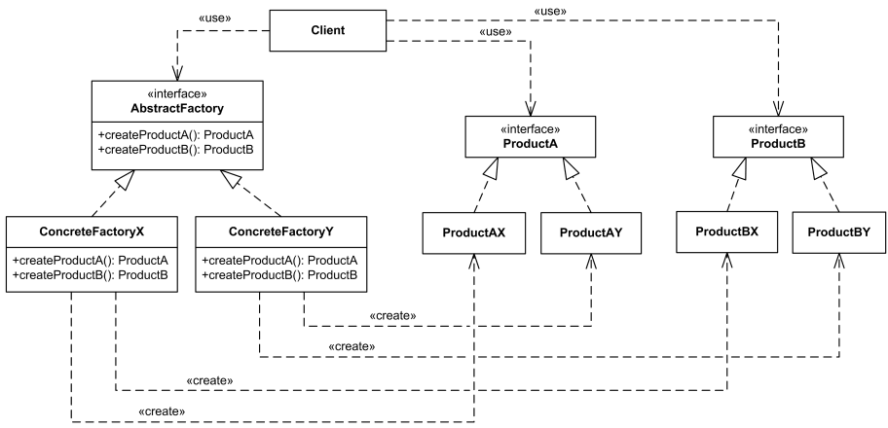
Abstract Factory
Problem: you have a family of related products (objects) and you need a lot of conditionals
Solution: factory of factories, adds an abstraction layer on factory, using composition (car has an engine, has a door etc.)

Slide 14
Abstract Factory in a few words + examples from open-source projects
Solves a specific problem: groups factories. It’s more like a framework. Keyword: family of factories
Usually, you start with a factory and realize you need a family of products and extend to abstract factory.
Recognizable by creational methods returning the factory itself, which in turn can be used to create another abstract/interface type
Is a bit complex, a lot of code, might be difficult to implement. It’s something that you design rather in the beginning, it’s hard to refactor.
Java: JDBC API, DocumentBuilderFactory, TransformerFactory, XPathFactory
.NET: DbProviderFactory class
https://docs.microsoft.com/en-us/dotnet/api/system.data.common.dbproviderfactory?view=net-5.0
Python: factory_boy
https://factoryboy.readthedocs.io/en/stable/index.html

Slide 15
Resources
[INTERNAL]
https://github.com/alexandraturian/food-delivery
https://github.com/alexandraturian/design-patterns
[EXTERNAL]
https://refactoring.guru/
https://addyosmani.com/resources/essentialjsdesignpatterns/book/
https://www.freecodecamp.org/news/tag/design-patterns/
Articles on https://medium.com/

